Slide 1
Multiplication EQuations
Grade 4, Module 1, Lesson 1

Slide 2
Do now
Pick two problems to solve. If you get done early work on the problems you didn’t do.
Title: Multiplication Equations
34 + 17
578 + 45
52 +9
176 – 33

Slide 3
Objective/Purpose
Interpret a multiplication equation as a comparison.

Slide 4
Now each of you is going to get a white board to work out problems on.
Who remembers expectations for white boards?

Slide 5
Copy this onto your white board
Who can tell me how to label this place value chart?

Slide 6
I do
Show 4 ones as place value disks. Write the number below it.
Show 4 ten disks and write the number below it.
Say the number in unit form.
4 tens 4 ones.
Say the number in standard form.
44.
4
4

Slide 7
We do
Show 3 ones as place value disks. Write the number below it.
Show 2 ten disks and write the number below it.
Say the number in unit form.
2 tens 3 ones
Say the number in standard form.
23

Slide 8
We do
Show 3 ones as place value disks. Write the number below it.
Show 2 hundred disks and write the number below it.
Say the number in unit form.
2 hundreds 3 ones
Say the number in standard form.
203

Slide 9
You do it together
Show 2 thousands 3 hundreds, as place value disks. Write the number below it.
Say the number in standard form.
2300

Slide 10
You do it together
Show 2 thousands 3 tens, as place value disks. Write the number below it.
Say the number in standard form.
2030

Slide 11
You do it alone
Show 2 thousands 3 hundreds 5 tens and 4 ones as place value disks. Write the number below it.
Say the number in standard form.
2354

Slide 12
Application Problem
Ben has a rectangular area 9 meters long and 6 meters wide. He wants a fence that will go around it as well as grass sod to cover it. How many meters of fence will he need? How many square meters of grass sod will he need to cover the entire area?

Slide 13
How many units do I have?
1
What is the name of this unit?
A one.
Count the ones with me.
10 ones.
What larger unit can I make?
1 ten. I change 10 ones for 1 ten. We say, “1 ten is 10 times as much as 1 one.”

Slide 14
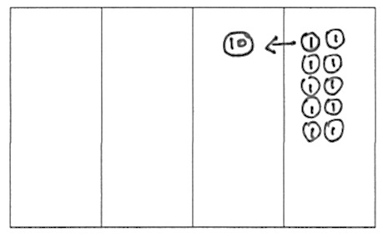
Tell your partner what we say and what that means. Use the model to help you.
10 ones make 1 ten.
10 times 1 one is 1 ten or 10 ones.
We say 1 ten is 10 times as many as 1 one.

Slide 15
How many units do I have?
1
What is the name of this unit?
A ten.
Count the tens with me.
10 tens.
What larger unit can I make?
1 hundred. I change 10 tens for 1 hundred.
We say, “1 hundred is 10 times as much as 1 ten.”

Slide 16
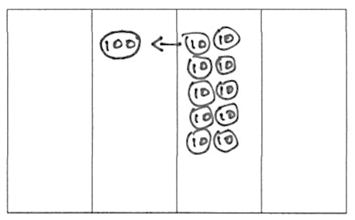
Tell your partner what we say and what that means. Use the model to help you.
10 tens make 1 hundred.
We say 1 hundred is 10 times as many as 1 ten.

Slide 17
How many units do I have?
1
What is the name of this unit?
A hundred.
Count the tens with me.
10 hundreds.
What larger unit can I make?
1 thousand. I change 10 hundreds for 1 thousand.
We say, “1 thousand is 10 times as much as 1 hundred.”

Slide 18
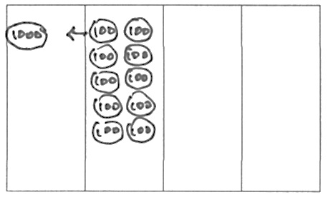
Tell your partner what we say and what that means. Use the model to help you.
10 hundreds make 1 thousand.
We say 1 thousand is 10 times as many as 1 hundred.

Slide 19
We do
Label your columns with the unit value. (10s, 1s)
Represent 2 ones.
Solve to find 10 times as many as 2 ones.
10 times as many as 2 ones is?
20 ones → 2 tens.
1000s | 100s | 10s | 1s

Slide 20
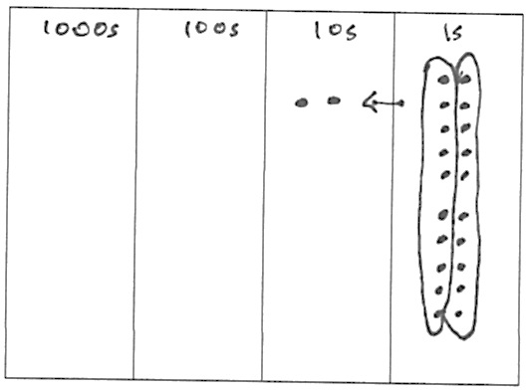
Explain this equation to your partner using your model.
10 × 2 ones = 20 ones = 2 tens

Slide 21
You do it together
Label your columns with the unit value. (10s, 1s)
Represent 4 tens.
Solve to find 10 times as many as 4 tens.
10 times as many as 4 tens is?
40 tens → 4 hundred.
1000s | 100s | 10s | 1s

Slide 22
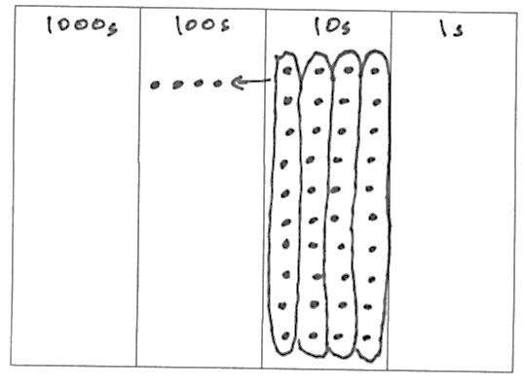
Explain this equation to your partner using your model.
10 × 4 tens = 40 tens = 4 hundred

Slide 23
You do it alone
Label your columns with the unit value. (10s, 1s)
Represent 7 tens.
Solve to find 10 times as many as7 tens.
10 times as many as 7 tens is?
70 tens→ 7 hundred.
1000s | 100s | 10s | 1s

Slide 24
Write an equation to find the value of 10 times as many as 9 hundreds.
Show me your boards. Read your equation.
10 × 9 hundreds = 90 hundreds = 9 thousands.

Slide 25
Turn and talk
Discuss whether this is true with your partner.
Yes it is true because 90 hundreds equals 9 thousands, so this equation just eliminates that extra step. → Yes, we know 10 of a smaller unit equals 1 of the next larger unit, so we just avoided writing that step.

Slide 26
Independent Practice
Complete the problem set independently.
Expectations:
  Voice level 0
  Stay in your seat
  Only working on your own paper and the problem set.

Slide 27
Discussion
What relationship do you notice between the problem of Matthew’s stamps and Problems 1(a) and 1(b)?
How did Problem 1(c) help you to solve Problem 4?
In Problem 5 which solution proved most difficult to find? Why?
How does the answer about Sarah’s age and her grandfather’s age relate to our lesson’s objective?

Slide 28
Discussion
What are some ways you could model 10 times as many? What are the benefits and drawbacks of each way of modeling? (Money, base ten materials, disks, labeled drawings of disks, dots on a labeled place value chart, tape diagram.)
Take 2 minutes to explain to your partner what we learned about the value of each unit as it moves from right to left on the place value chart.
Write and complete the following statements:
_____ ten is _____ times as many as _____ one.
_____ hundred is _____ times as many as _____ ten.
_____ thousand is _____ times as many as _____ hundred.

Slide 29
Exit Ticket
Time to show me what you have learned!
Expectations:
  Voice level 0
  Stay in your seat
  Try your best!

