Slide 1
Multiplying by base 10s
Grade 4, Module 1, Lesson 2

Slide 2
Do Now
Derek has 78 pencils and Jovann gives him 21 more. How many pencils does Derek now have?
Title: Multiplying and Dividing by 10s

Slide 3
Objective/Purpose
Recognize a digit represents 10 times the value of what it represents in the place to its right.

Slide 4
Now each of you is going to get a white board to work out problems on.
Who remembers expectations for white boards?

Slide 5
I do
Show 5 tens as place value disks, and write the number below it.
Say the number in unit form
5 tens.
Say the number in standard form.
50.
5

Slide 6
We do
Show 3 ones as place value disks. Write the number below it.
Show 4 hundred disks and write the number below it.
Say the number in unit form.
4 hundred 3 ones
Say the number in standard form.
403

Slide 7
We do
Show 3 ones as place value disks. Write the number below it.
Show 2 hundred disks and write the number below it.
Say the number in unit form.
2 hundreds 3 ones
Say the number in standard form.
203

Slide 8
You do it together
Show1 thousand 2 hundreds, as place value disks. Write the number below it.
Say the number in standard form.
1200

Slide 9
You do it together
Show4 thousands 2 tens, as place value disks. Write the number below it.
Say the number in standard form.
4020

Slide 10
You do it alone
Show 4 thousands 2 hundreds 3 tens 5 ones as place value disks. Write the number below it.
Say the number in standard form.
4235

Slide 11
Fill in the blank.
(write the complete number sentence on your white board)
I do
10 ones × 10 = 1 ______.
10 ones × 10 = 1 hundred
Say the multiplication sentence in standard form.
10 × 10 = 100.

Slide 12
Fill in the blank.
(write the complete number sentence on your white board)
We do
10 × _____ = 2 hundreds
10 × 20 = 2 hundred
Say the multiplication sentence in standard form.
10 × 20 = 200.

Slide 13
Fill in the blank.
(write the complete number sentence on your white board)
We do
10 × ______ = 7 hundreds
10 × 70 = 7 hundred
Say the multiplication sentence in standard form.
10 × 70 = 700.

Slide 14
Fill in the blank.
(write the complete number sentence on your white board)
You do it together
10 × 1 hundred = 1 _______
10 x 1 hundred = 1000
10 x 100 = 1000
10 × ____ = 2 thousands;
10 x 200 = 2 thousands
10 x 200 = 2000

Slide 15
Fill in the blank.
(write the complete number sentence on your white board)
You do it alone
10 × ______ = 8 thousands
10 x 800 = 8 thousands
10 x 800 = 8000
10 × 10 thousands = ______.
10 x 10 thousands = 100,000
10 x 10,000 = 100,000

Slide 16
Application Problem
Amy is baking muffins. Each baking tray can hold 6 muffins. If Amy bakes 4 trays of muffins, how many muffins will she have in all?
The corner bakery produced 10 times as many muffins as Amy baked. How many muffins did the bakery produce?
Extension: If the corner bakery packages the muffins in boxes of 100, how many boxes of 100 could they make?

Slide 17
All of you are going to get a unlabeled place value chart.
Also make sure that your white board is clean.

Slide 18
Label ones, tens, hundreds, and thousands on your place value chart.
On your personal white board, write the multiplication sentence that shows the relationship between 1 hundred and 1 thousand.
10 × 1 hundred = 10 hundreds = 1 thousand
Draw place value disks on your place value chart to find the value of 10 times 1 thousand.

Slide 19
I saw that some of you drew 10 disks in the thousands column. What does that represent?
10 times 1 thousand equals 10 thousands.
(10 × 1 thousand = 10 thousands.)
How else can 10 thousands be represented?
10 thousands can be bundled because, when you have 10 of one unit, you can bundle them and move the bundle to the next column.
Can anyone think of what the name of our next column after the thousands might be?
Now label the ten thousands column.

Slide 20
Now write a complete multiplication sentence to show 10 times the value of 1 thousand. Show how you regroup.
Write 10 × 1 thousand = 10 thousands = 1 ten thousand
On your place value chart, show what 10 times the value of 1 ten thousand equals.
What is 10 times 1 ten thousand?
10 ten thousands. → 1 hundred thousand.
That is our next larger unit.
10 × 1 ten thousand = 10 ten thousands = 1 hundred thousand
To move another column to the left, what would be my next 10 times statement?
10 times 1 hundred thousand.

Slide 21
Solve to find 10 times 1 hundred thousand.
10 hundred thousands can be bundled and represented as 1 million.
Title your column and write the multiplication sentence.
10 × 1 hundred thousand = 10 hundred thousands = 1 million
Now we are going to review how to move around on the place value chart.

Slide 22
Fill in the blank.
2 tens times 10 = ________
2 hundreds
2 hundreds times 10 = ________
2 thousands
2 thousands divided by 10 =________
2 hundreds
2 hundreds divided by 10 =________
2 tens

Slide 23
More practice
Draw place value disks and write a multiplication sentence to show the value of 10 times 4 ten thousands.
10 times 4 ten thousands is?
40 ten thousands. → 4 hundred thousands.
10 × 4 ten thousands = 40 ten thousands = 4 hundred thousands.)
Explain to your partner how you know this equation is true.

Slide 24
More practice
Draw place value disks and write a multiplication sentence to show the value of 10 × 3 hundred thousands.
10 times 3 hundred thousands is?
30 hundred thousands. → 3 million.
10 × 3 hundred thousands = 30 hundred thousands = 3 million
Explain to your partner how you know this equation is true.

Slide 25
Now let’s practice with division.
2 thousands ÷ 10
What is the process for solving this division expression?
Use a place value chart. → Represent 2 thousands on a place value chart. Then change them for smaller units so we can divide.
What would our place value chart look like if we changed each thousand for 10 smaller units?
20 hundreds. → 2 thousands can be changed to be 20 hundreds because 2 thousands and 20 hundreds are equal.

Slide 26
Now let’s practice with division.
2 thousands ÷ 10
Solve for the answer.
2 hundreds.
2 thousands ÷ 10 is 2 hundreds because 2 thousands unbundled becomes 20 hundreds.
20 hundreds divided by 10 is 2 hundreds. →
2 thousands ÷ 10 = 20 hundreds ÷ 10 = 2 hundreds.

Slide 27
Now let’s practice with division.
3 hundred thousands ÷ 10
What is the process for solving this division expression?
Use a place value chart. → Represent 3 hundred thousands on a place value chart. Then change them for smaller units so we can divide.
What would our place value chart look like if we changed each thousand for 10 smaller units?
30 ten thousands.
3 hundred thousands can be changed to be 30 ten thousands because 3 hundred thousands and 30 ten thousands are equal.

Slide 28
Now let’s practice with division.
3 hundred thousands ÷ 10
Solve for the answer.
3 ten thousands
3 hundred thousands ÷ 10 is 3 ten thousands because 3 hundred thousands unbundled becomes 30 ten thousands.
30 ten thousands divided by 10 is 3 tens thousands. → 3 hundred thousands ÷ 10 = 30 ten thousands ÷ 10 = 2 ten thousands.

Slide 29
10 × (3 hundreds 2 tens).
Work in pairs to solve this expression.
What is your product?
3 thousands 2 hundreds.
10 × (3 hundreds 2 tens) = 3 thousands 2 hundreds.
How do we write this in standard form?
3,200.
Write 10 × (3 hundreds 2 tens) = 3 thousands 2 hundreds = 3,200.
Thousands | Hundreds | Tens | Ones

Slide 30
(7 hundreds 9 tens) ÷ 10
Work in pairs to solve this expression.
What is your product?
7 tens 9 ones
(7 hundreds 9 tens) ÷ 10) =7 tens 9 ones
How do we write this in standard form?
79
Thousands | Hundreds | Tens | Ones

Slide 31
10 × (4 thousands 5 hundreds)
Solve this expression alone.
What is your product?
4 ten thousands 5 thousand.
10 × (4 thousands 5 hundreds) =4 ten thousands 5 thousand.
How do we write this in standard form?
45,000.
Ten Thousands | Thousands | Hundreds | Tens | Ones

Slide 32
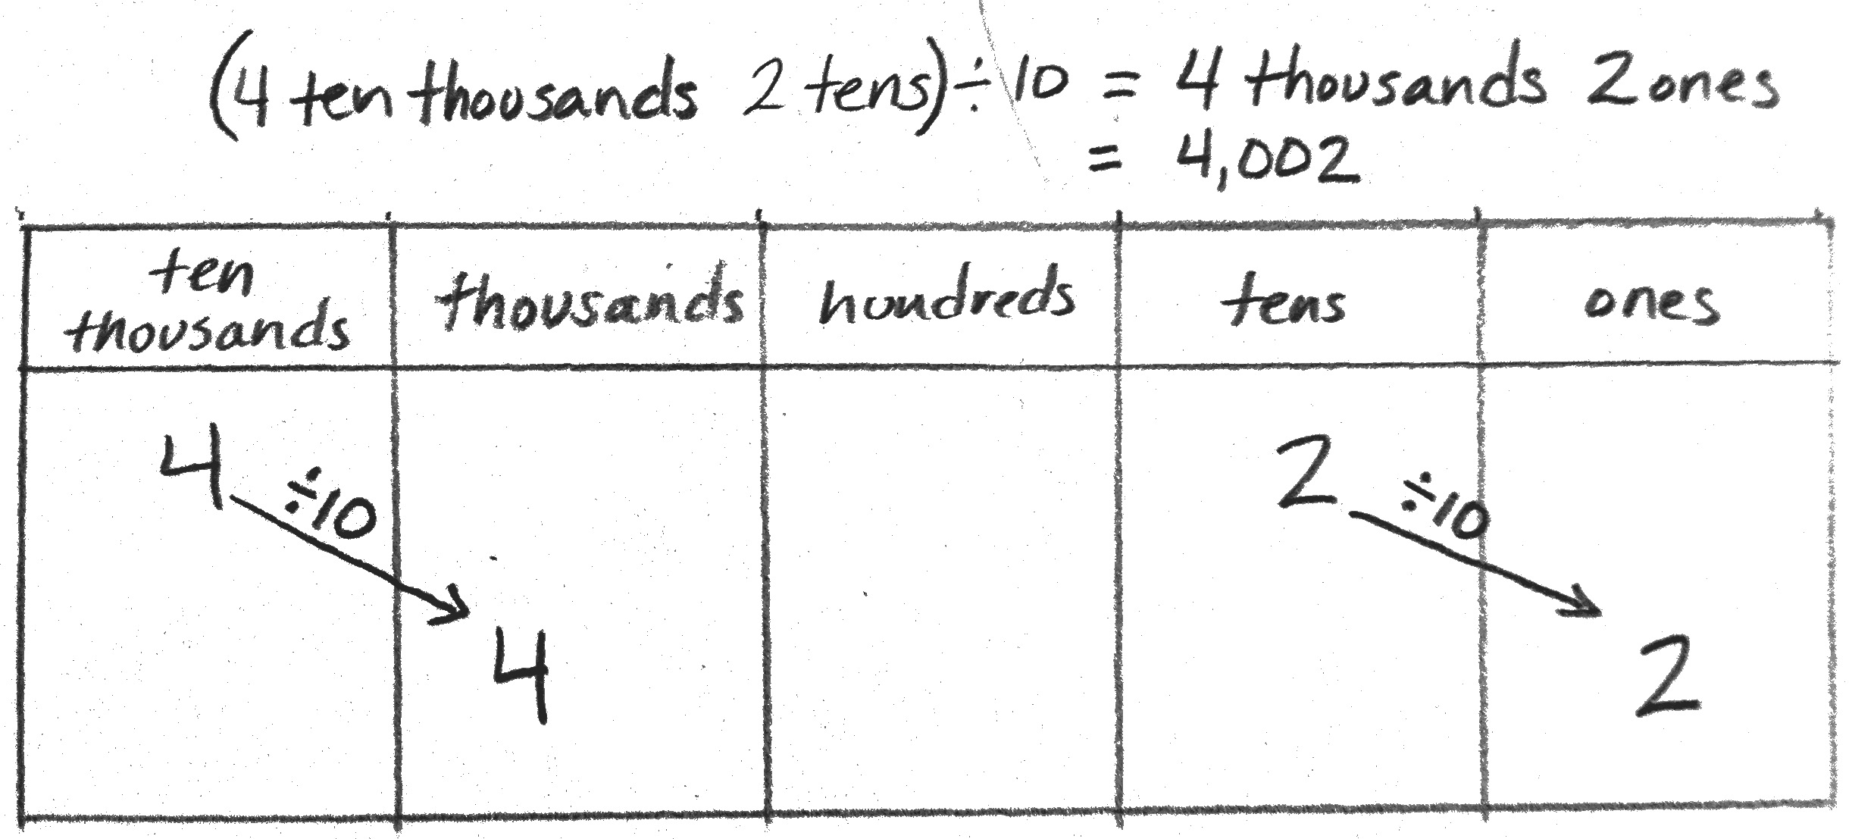
4 ten thousands 2 tens) ÷ 10
Solve this expression alone.
In this expression we have two units. Explain how you will find your answer.
We can use the place value chart again and represent the unbundled units, then divide
Watch as I represent numbers in the place value chart to multiply or divide by ten instead of drawing disks.

Slide 33
Independent Practice
Complete the problem set independently.
Expectations:
  Voice level 0
  Stay in your seat
  Only working on your own paper and the problem set.

Slide 34
Discussion
How did we use patterns to predict the increasing units on the place value chart up to 1 million?
Can you predict the unit that is 10 times 1 million? 100 times 1 million?
What happens when you multiply a number by 10? 1 ten thousand is what times 10?
1 hundred thousand is what times 10?
Gail said she noticed that when you multiply a number by 10, you shift the digits one place to the left and put a zero in the ones place.
Is she correct?

Slide 35
Discussion
How can you use multiplication and division to describe the relationship between units on the place value chart? Use Problem 1(a) and (c) to help explain.
Practice reading your answers in Problem 2 out loud. What similarities did you find in saying the numbers in unit form and standard form? Differences?
In Problem 7, did you write your equation as a multiplication or division sentence? Which way is correct?

Slide 36
Discussion
Which part in Problem 3 was hardest to solve?
When we multiply 6 tens times 10, as in Problem 2, are we multiplying the 6, the tens, or both?
Does the digit or the unit change?
Is 10 times 6 tens the same as 6 times 10 tens?
(Use a place value chart to model.)
Is 10 times 10 times 6 the same as 10 tens times 6? (Use a place value chart to model 10 times 10 is the same as 1 ten times 1 ten.)
When we multiply or divide by 10, do we change the digits or the unit? Make a few examples.

Slide 37
Exit Ticket
Time to show me what you have learned!
Expectations:
  Voice level 0
  Stay in your seat
  Try your best!

