Slide 1
Susette’s Recommended MSTEP Math Prep
March 2016

Slide 2
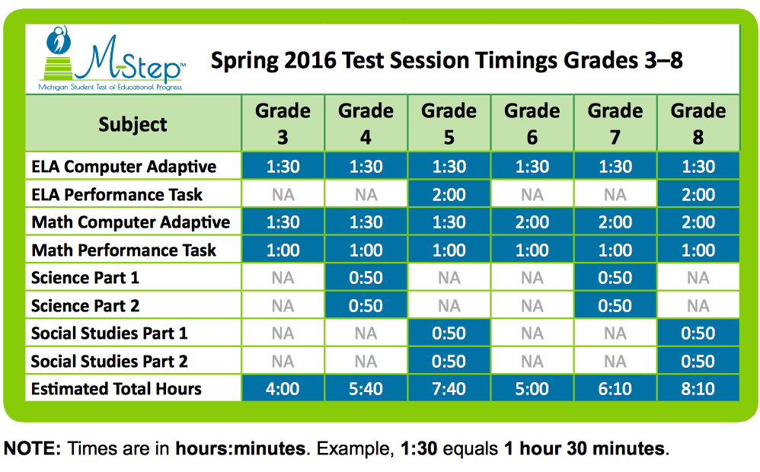

Slide 3
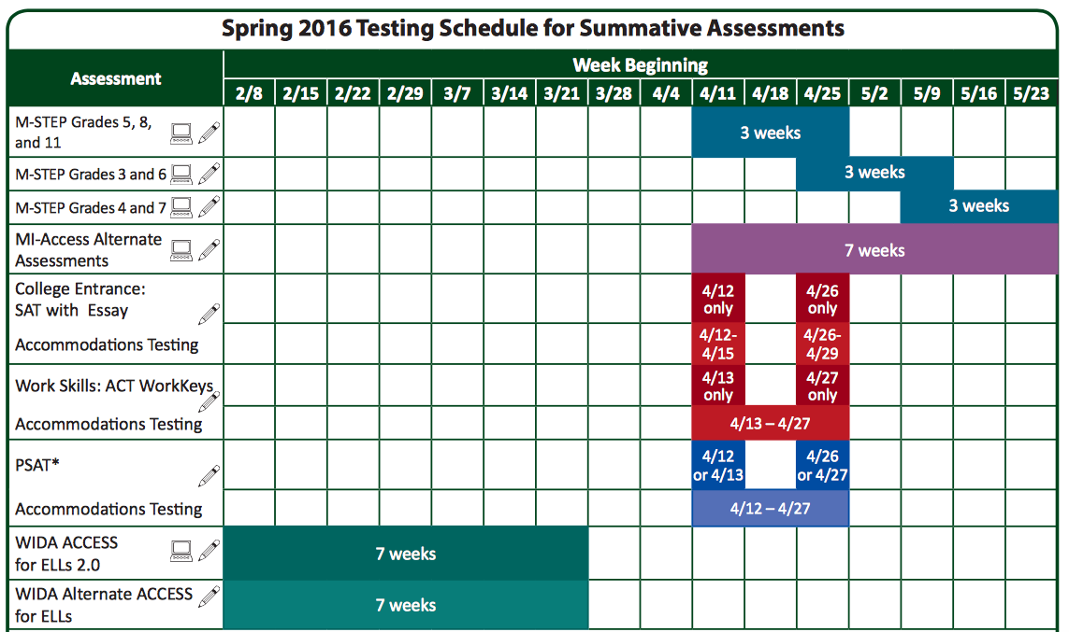

Slide 4
– Scratch paper is allowed for the online tests.

Slide 5
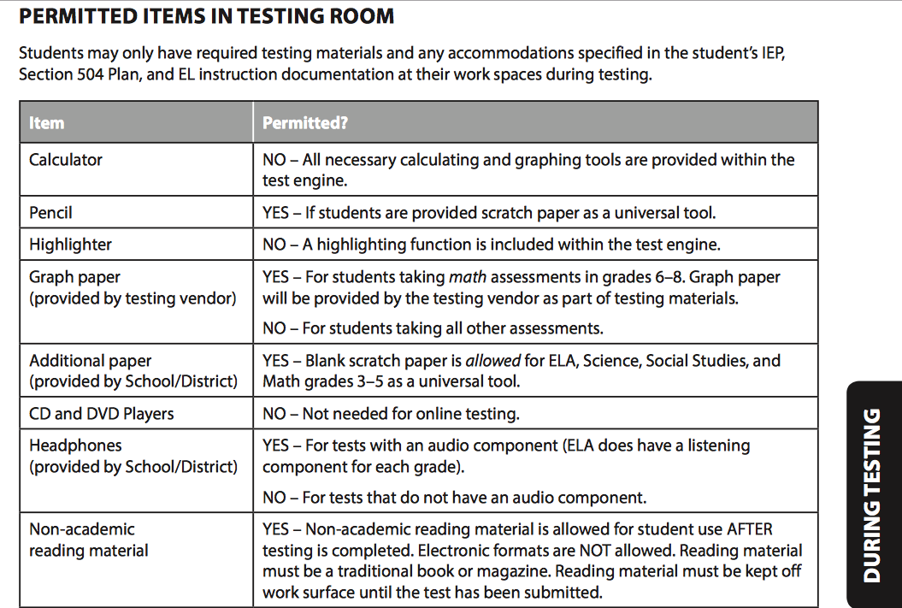

Slide 6
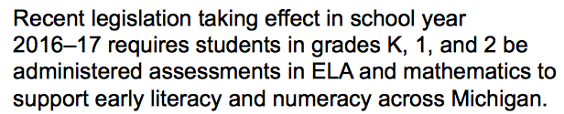
A Note for Next Year…

Slide 7

Things To Do
Students
Calculator Practice
Preview Sample Set(s)
ALEKS Practice Problems
Performance Task Practice
Teachers
Calculator Practice
Spring 2016 Preview and Preview Sample Set(s)
Select Practice Problems using ALEKS
Select Performance Task Practice Problems
To hear audio, download the PowerPoint.
Note: High School students take MSTEP science and social studies only.

Slide 8
Links to Web Sites
Michigan Department of Education MSTEP info
MDE MSTEP Summative
MSTEP Online Preview
The M-STEP Spring 2016 Preview must be used in Google Chrome.
Copy and paste the link below into Google Chrome. https://wbte.drcedirect.com/MI/portals/mi/ott1
Click on the 2016 Preview Link, you will then need to click to sign on. Once on the sign in page, use the username and password displayed on the screen to log in.
ALEKS (For Practice Problems)
http://www.aleks.com
Engage NY (For Performance Tasks)
https://www.engageny.org
Inside Mathematics (For Performance Tasks)
http://www.insidemathematics.org
Hyperlinks are “hot” in presentation mode. In normal view, right-click the link and select "Open Hyperlink"

Slide 9
For Grades 6th - 8th
Calculator Practice
Grades 3rd - 5th: No calculators allowed.

Slide 10

Using Google Chrome only, go to:
https://wbte.drcedirect.com/MI/portals/mi/ott1
Select Calculator Practice.

Slide 11
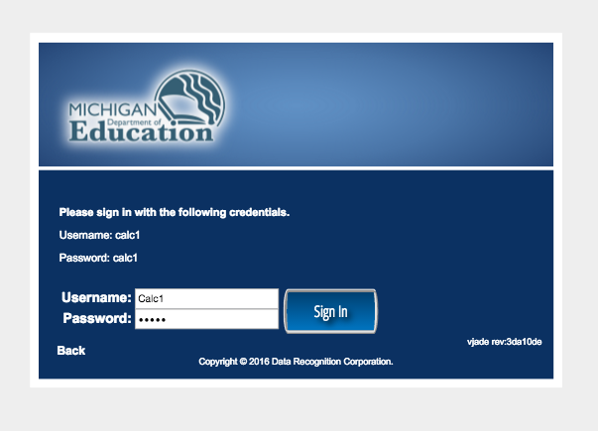

Slide 12
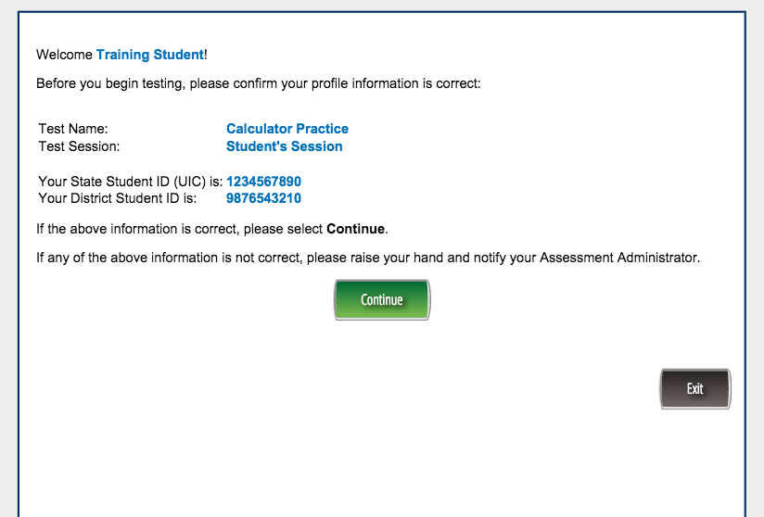

Slide 13
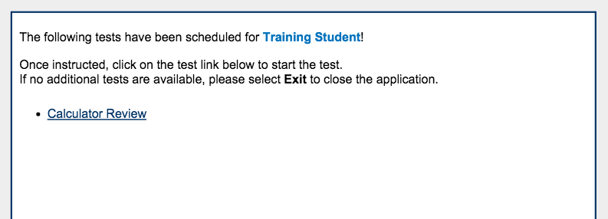

Slide 14
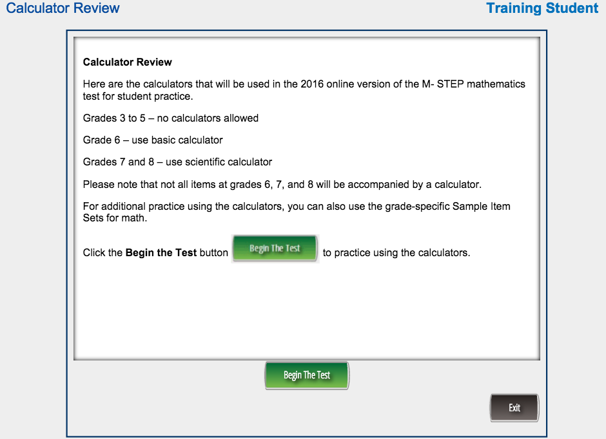

Slide 15
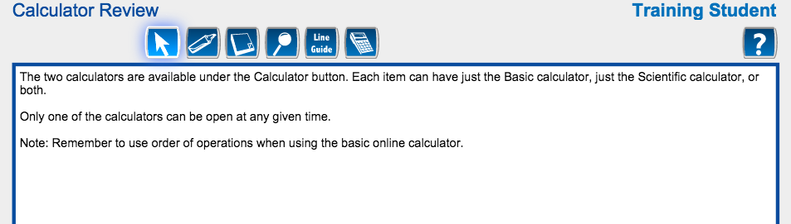

Slide 16
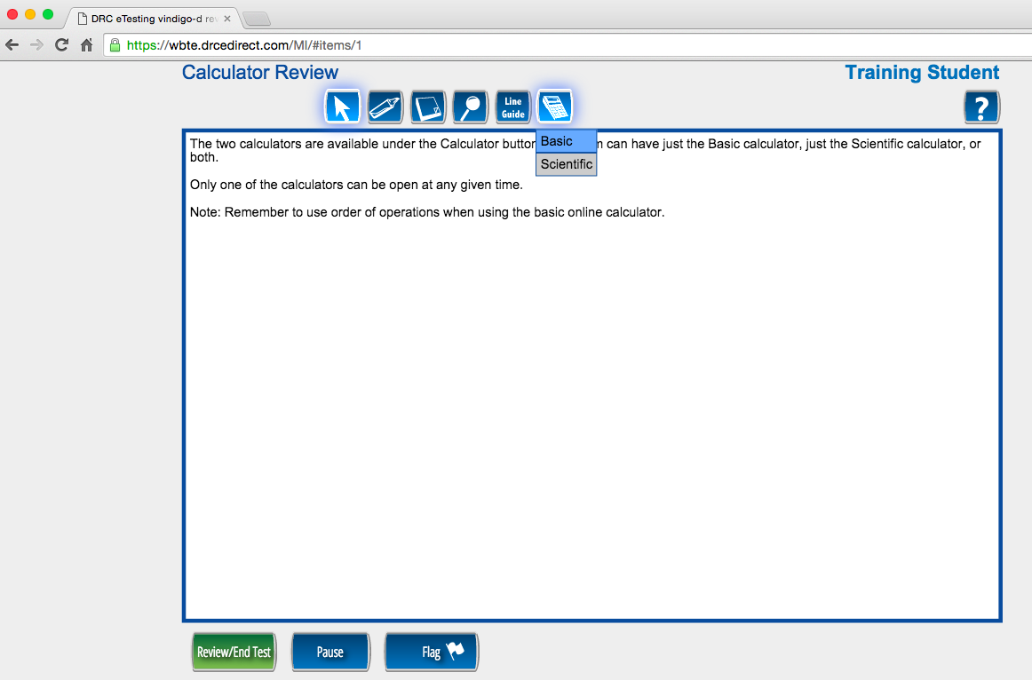

Slide 17
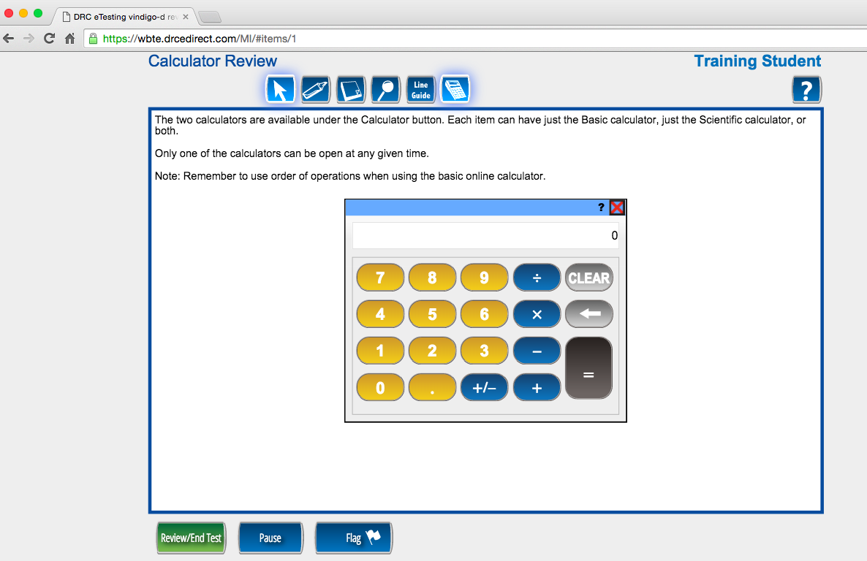

Basic Calculator for 6th grade.
Reminder: 3rd – 5th graders do not use calculators on the MSTEP.

Slide 18
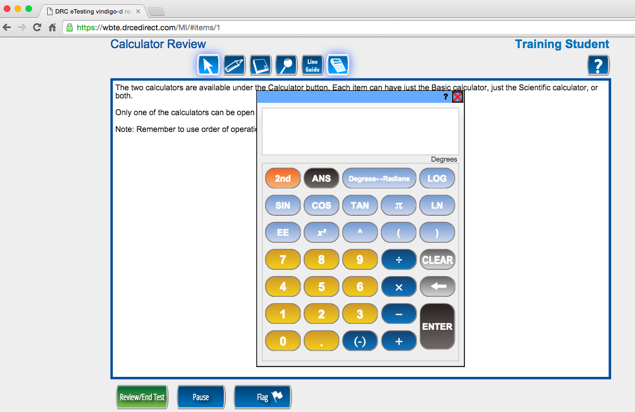
Scientific Calculator for 7th and 8th grades.

Slide 19
Preview
Sample Item Sets
There have been three main adjustments from last year which have allowed a reduction in testing time:
the adjustments to the ELA M-STEP so that performance tasks would only be included in grades 5 and 8;
the removal of classroom activities in both ELA and mathematics;
there is no longer an 11th grade ELA or mathematics M-STEP, as MDE will be able to use the SAT for 11th grade ELA and mathematics accountability.

Slide 21
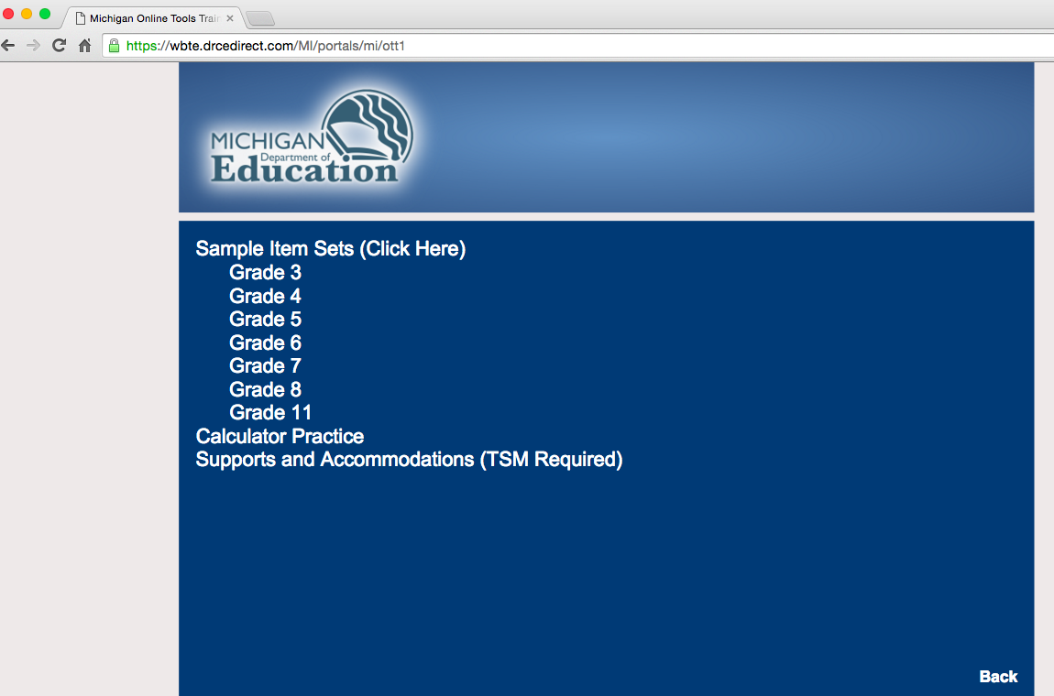

Slide 22
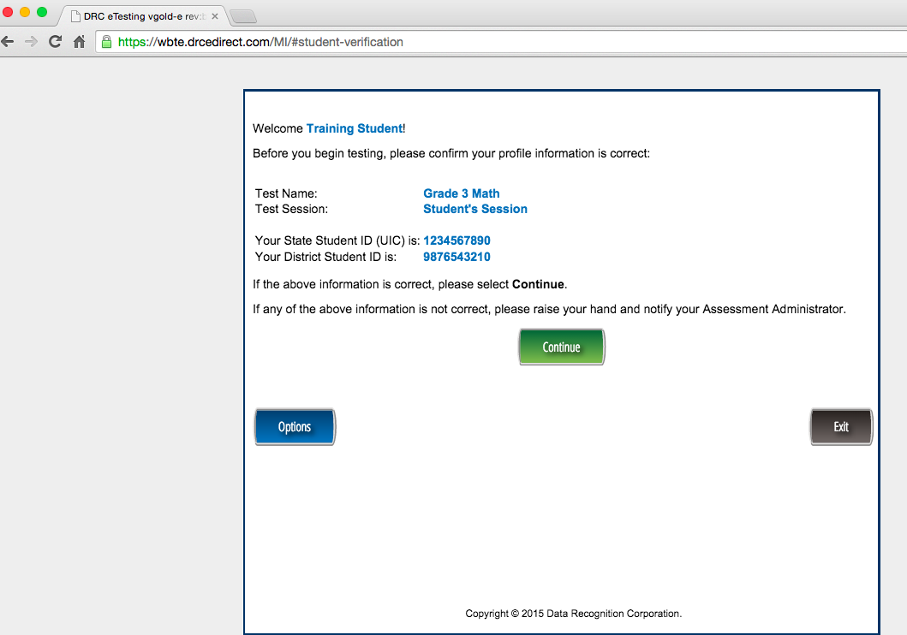

Slide 23
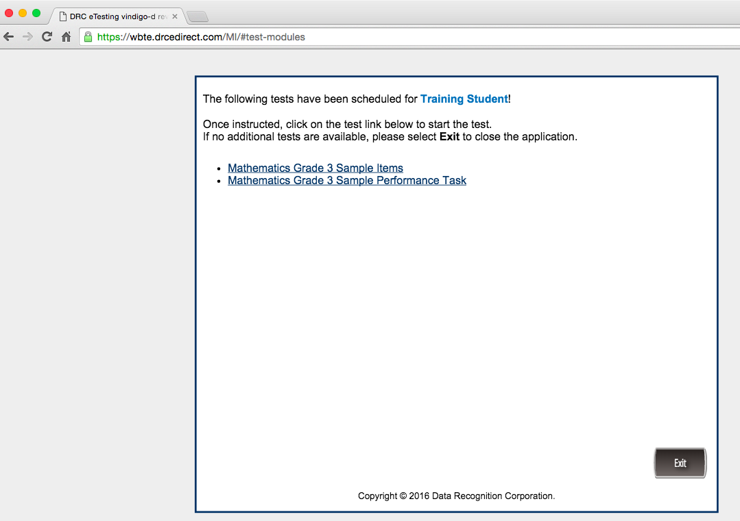

Slide 24
A Look at the
Grade 3 Sample Items

Slide 25
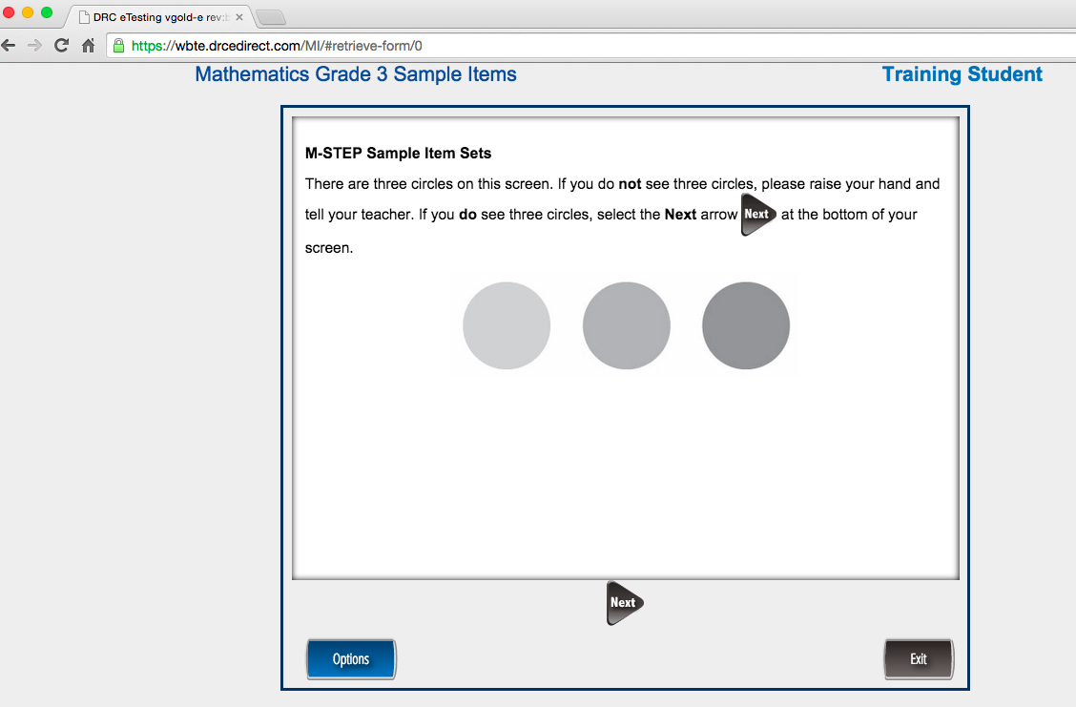

Slide 26
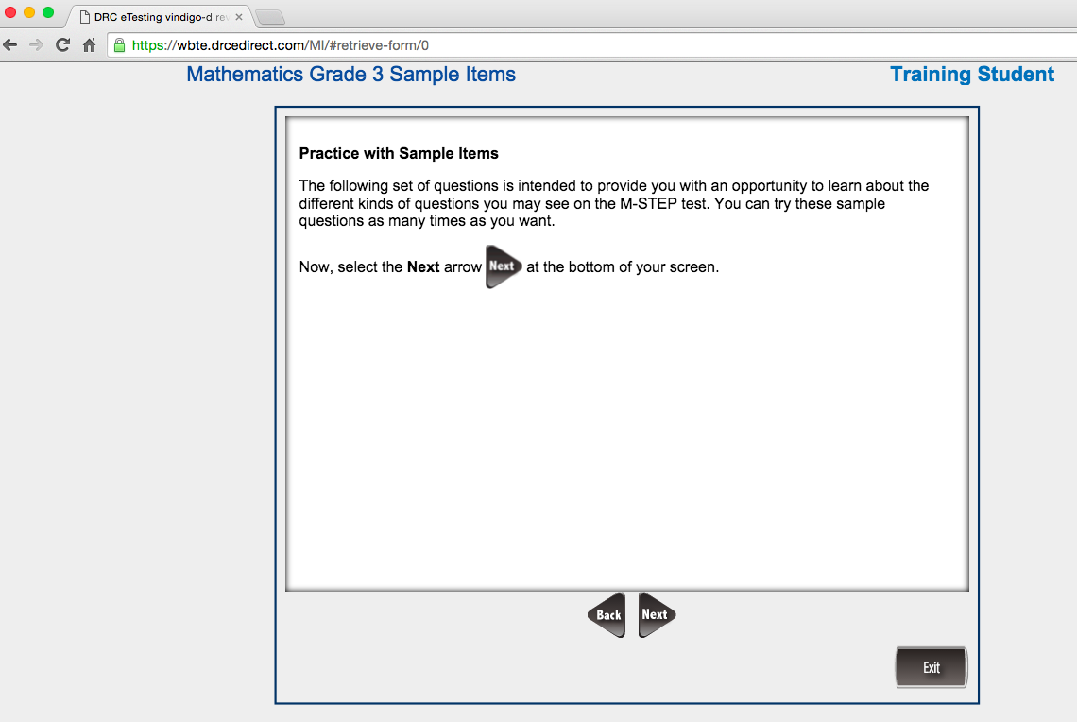

Slide 27
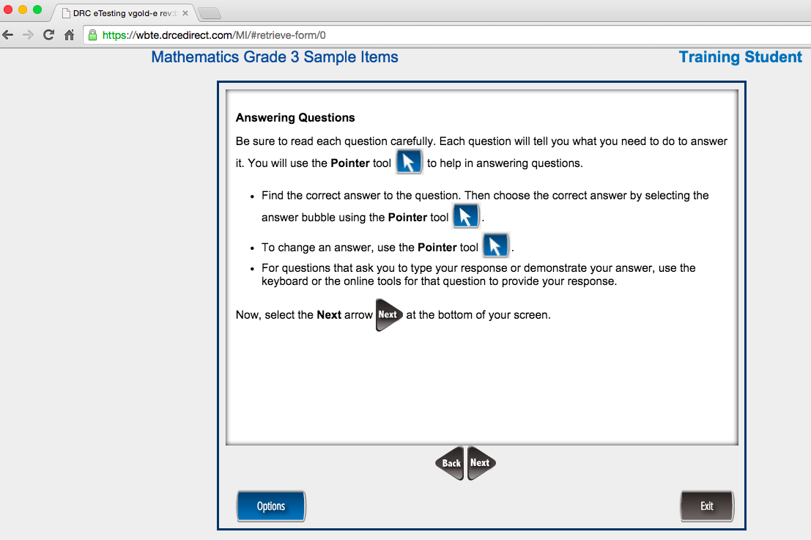

Slide 28
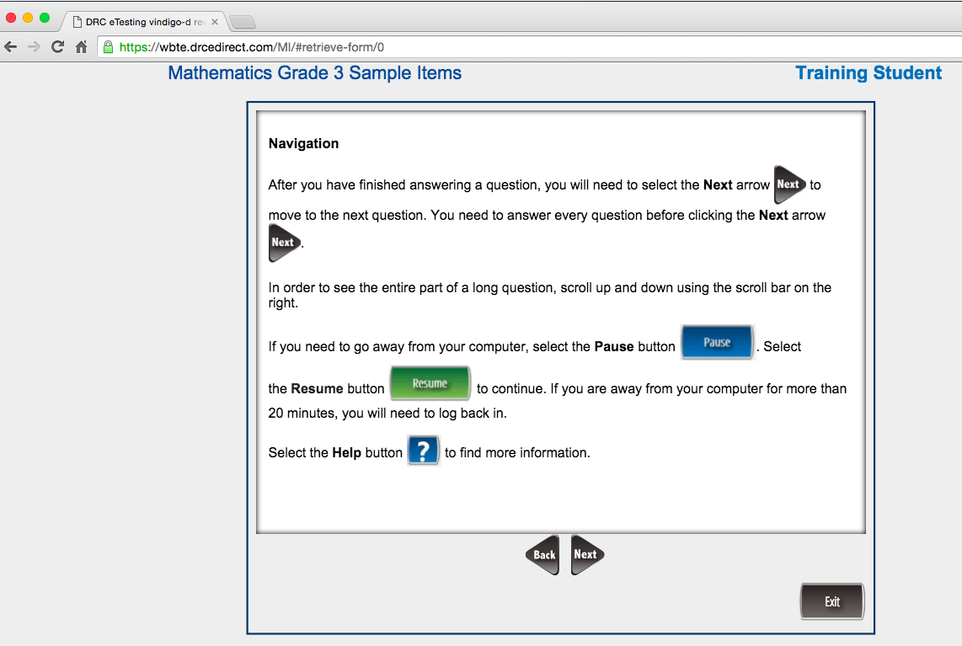

Slide 29
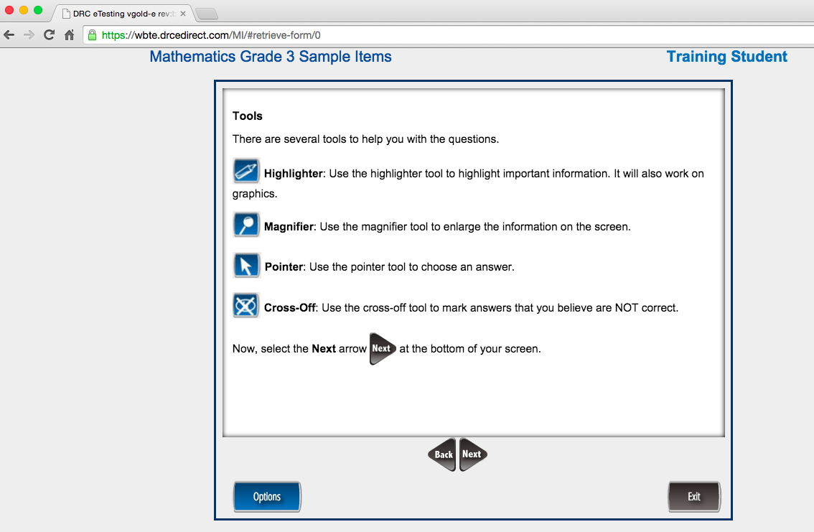

Slide 30
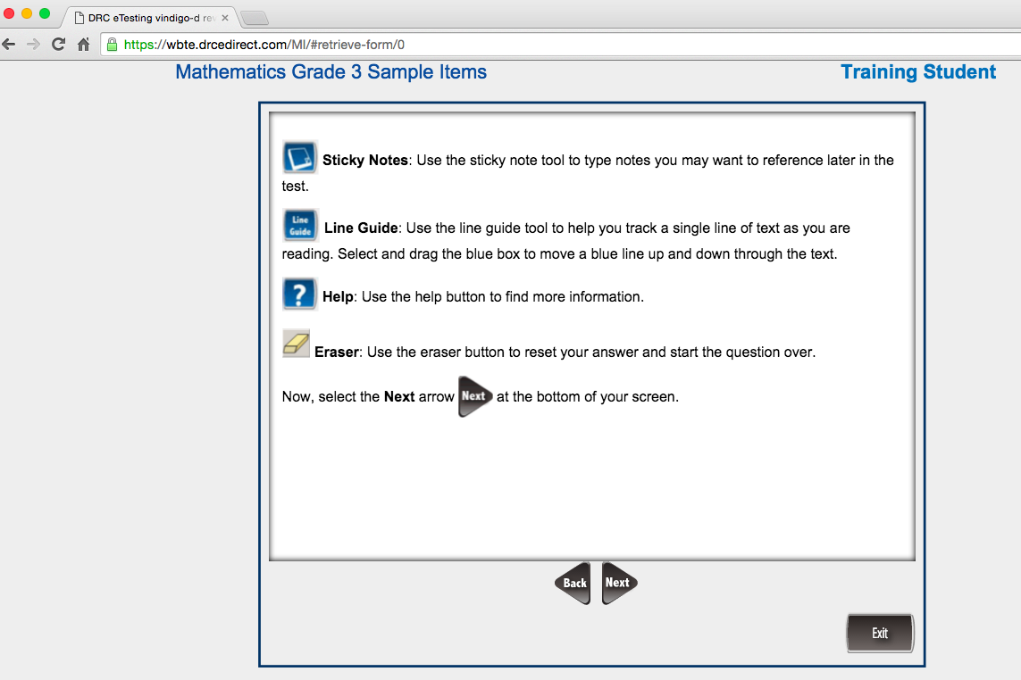

Slide 31
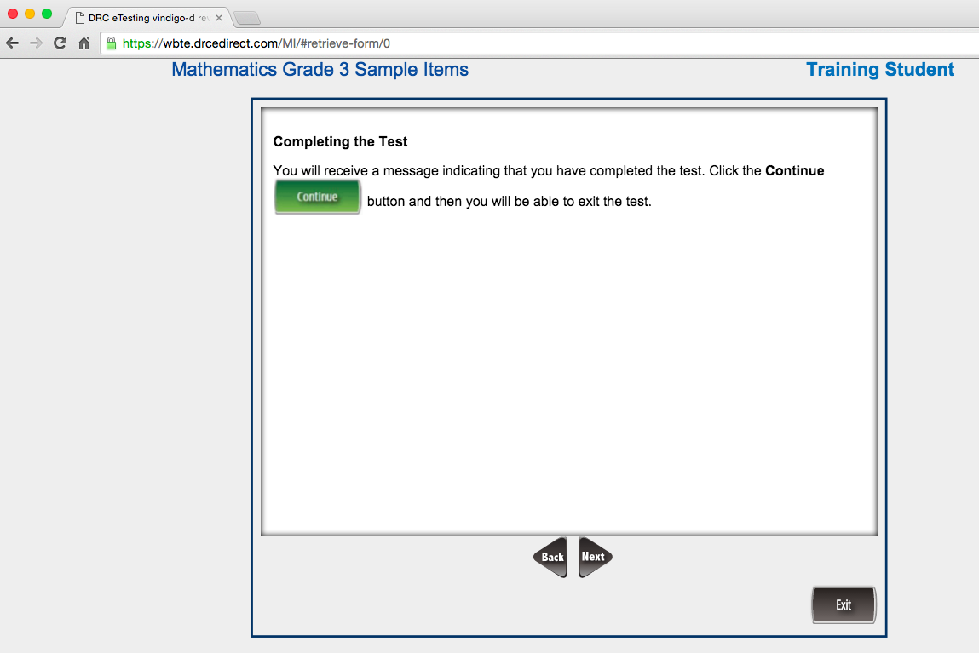

Slide 32
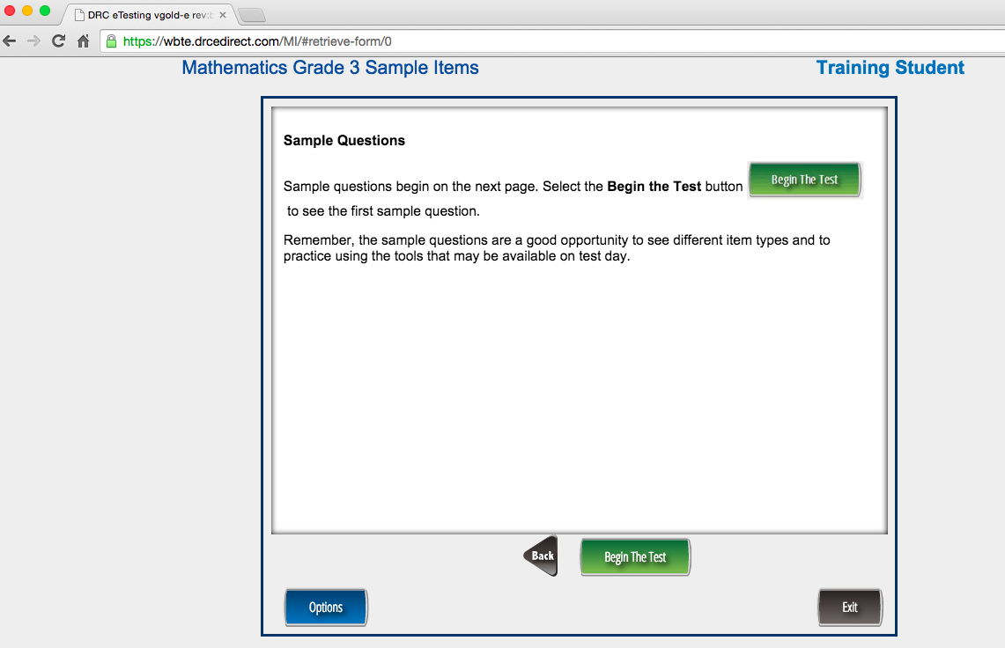

Slide 33
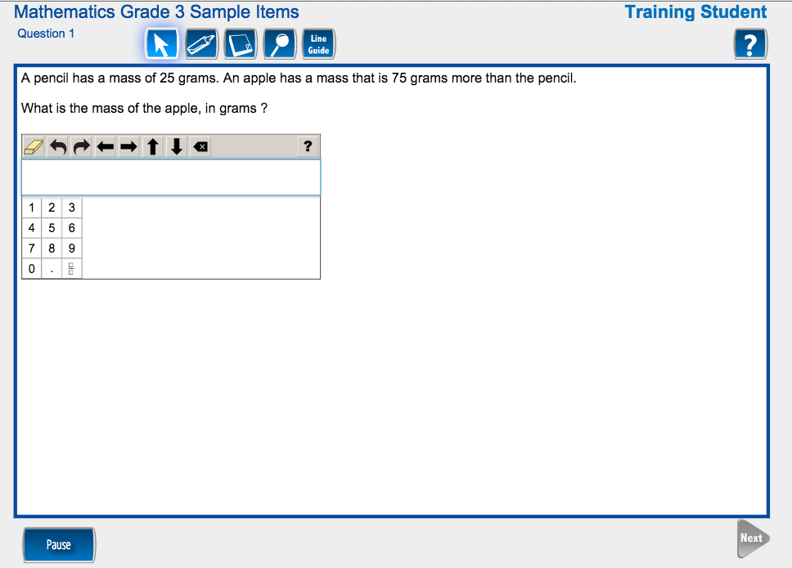
100
Classroom Practice Tip
Have students create a similar problem by replacing the pencil and apple with 2 other items.
Have students create a similar problem by replacing the 25 and 75 with 2 other numbers.
Have students create a similar problem by replacing the pencil and apple with 2 other items and the 25 and 75 with 2 other numbers.
Have students create a similar problem that requires subtraction instead of addition.
Have students create a similar problem that requires addition but uses a phrase different than “more than”.
Have student weigh or measure two items and create a problem based on the measurements.

Slide 34
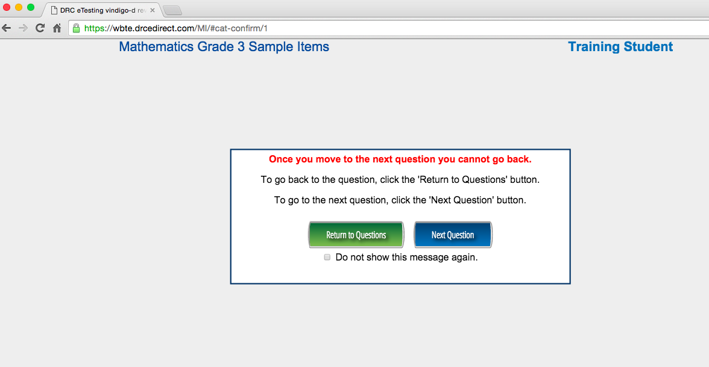
This message will continue to show after each problem unless students check the box.

Slide 35
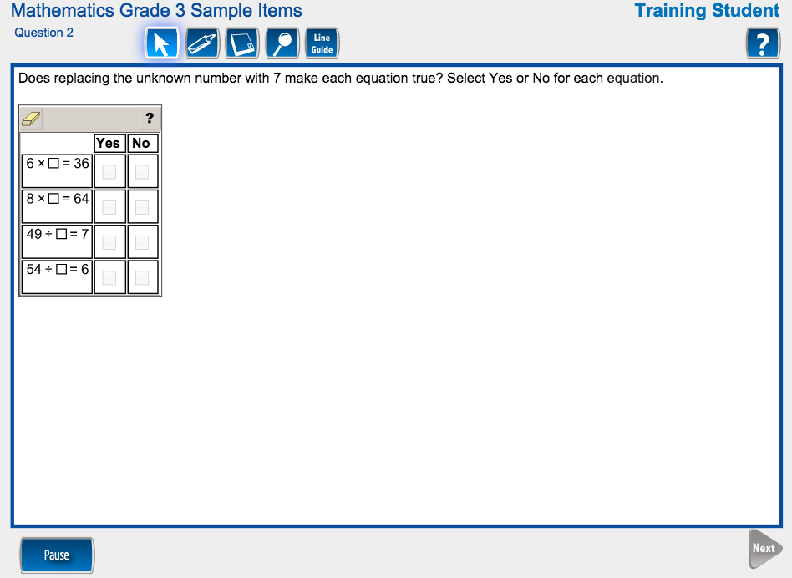

Slide 36
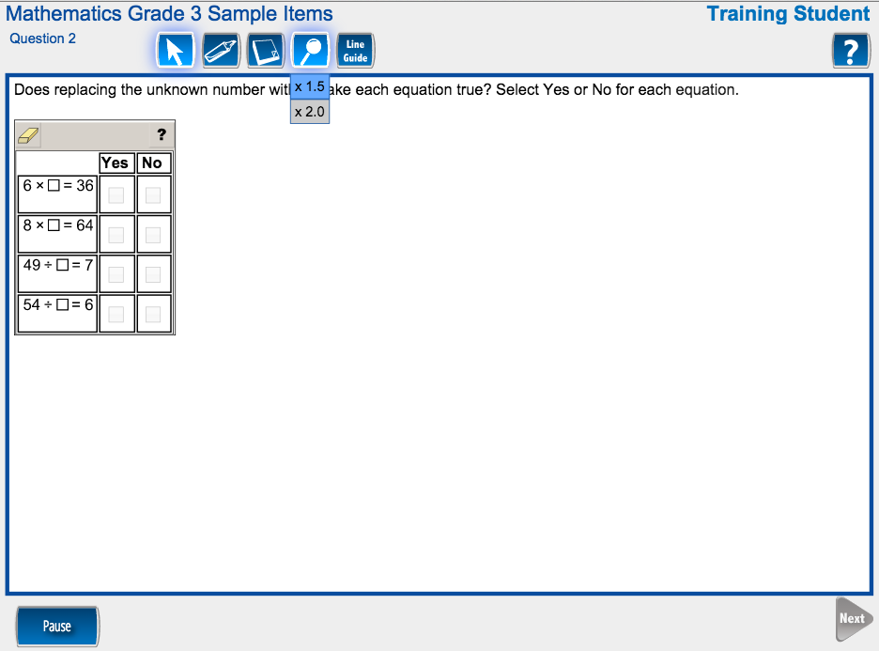

Slide 37
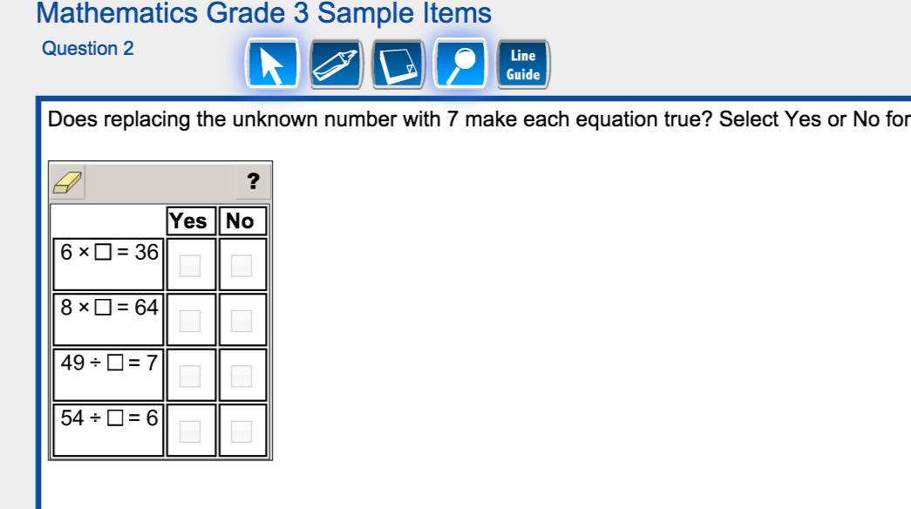
X
X
X
X

Slide 38
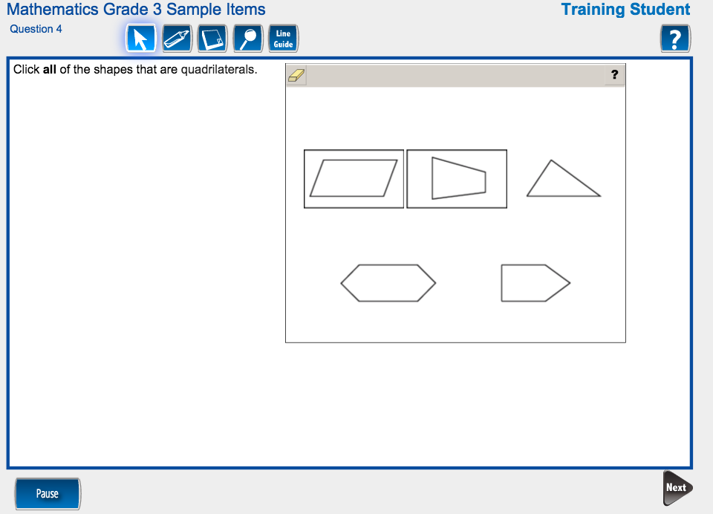
Classroom Practice Tip
Have students create a similar problem that would have 3 correct answers .

Slide 39
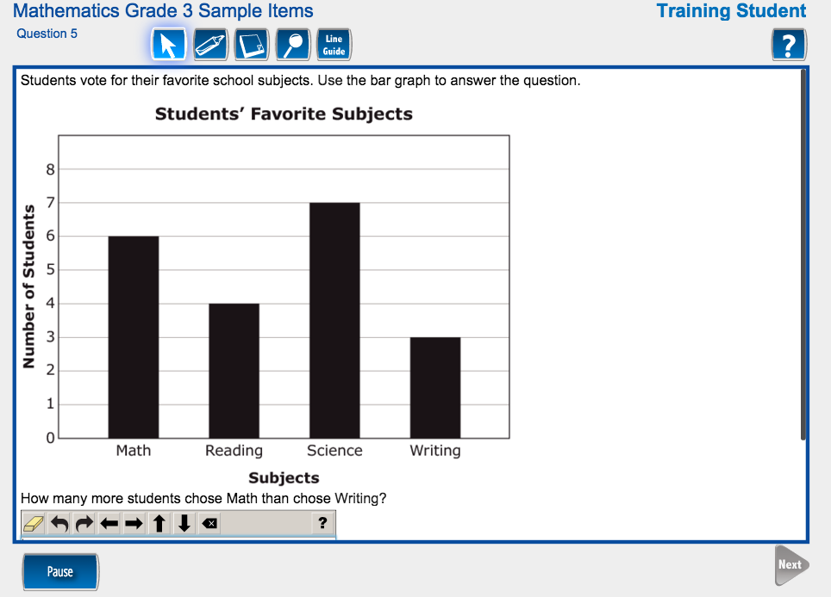

Slide 40
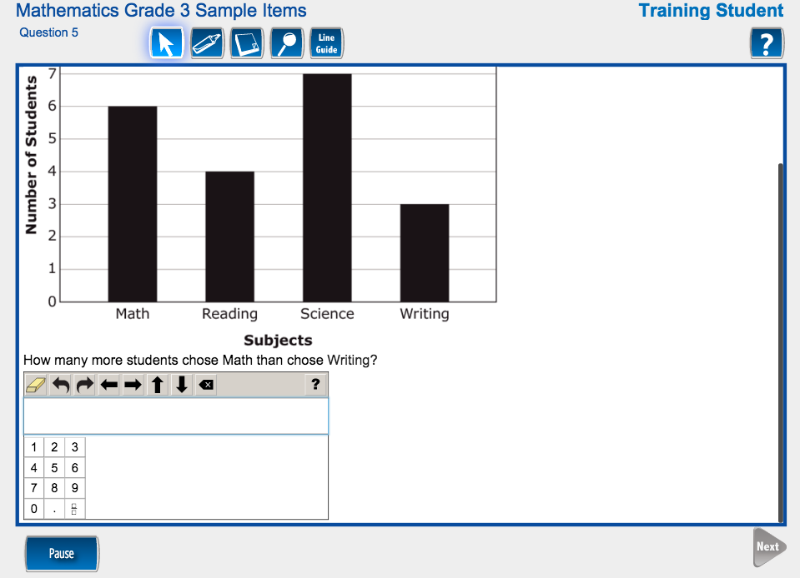
3

Slide 41
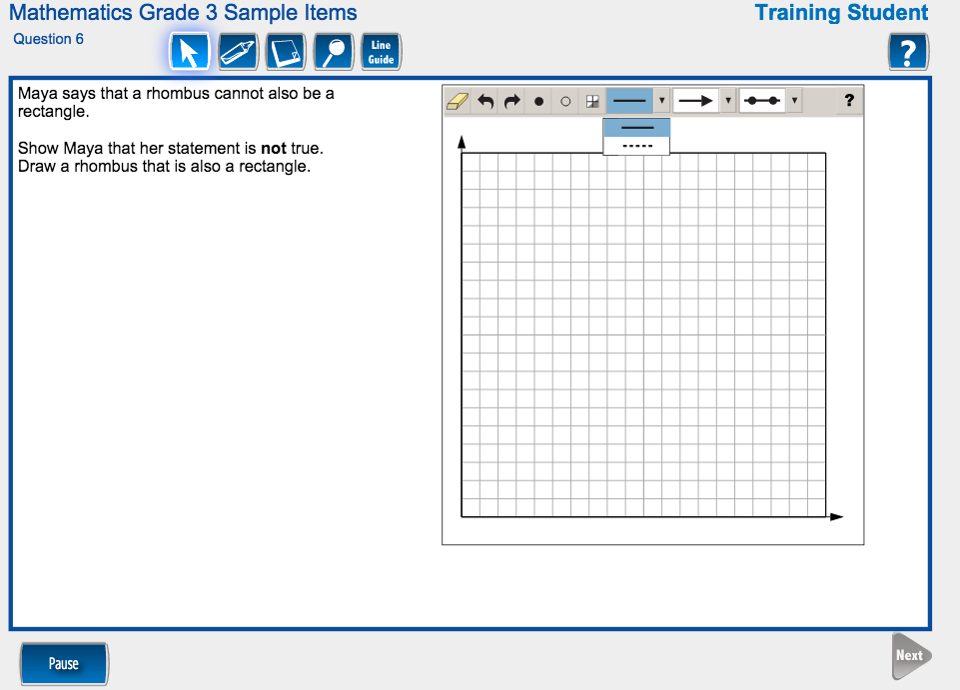

Slide 42
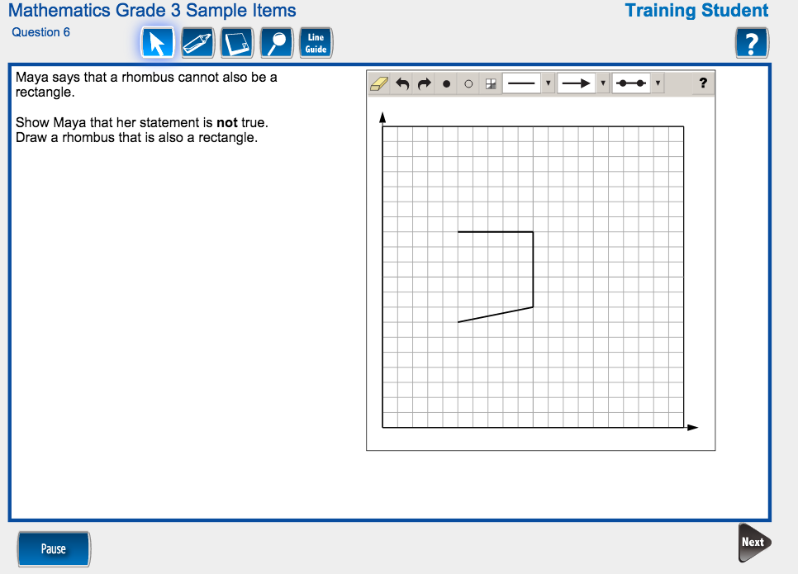

Slide 43
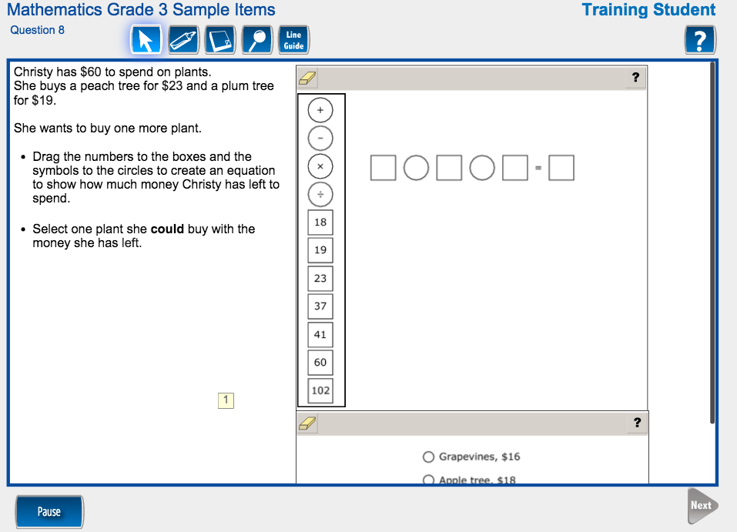

Slide 44
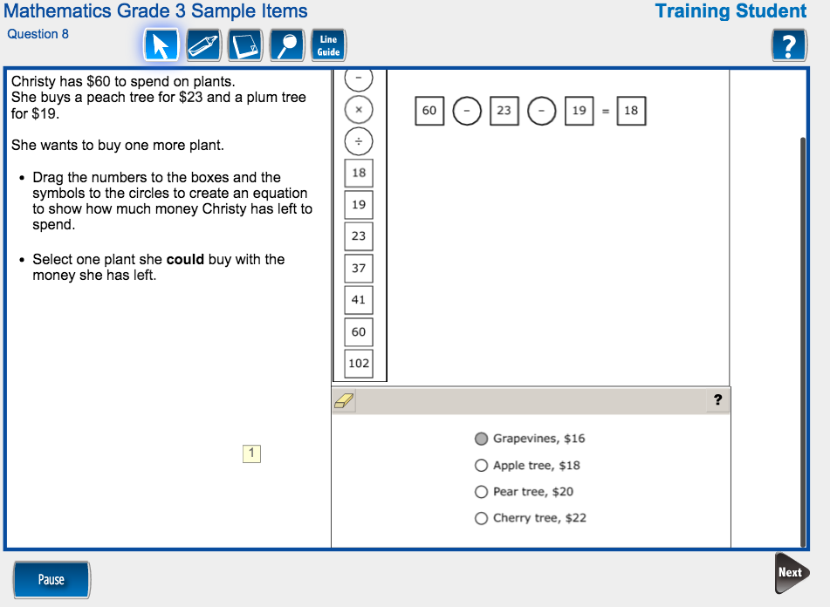

Slide 45
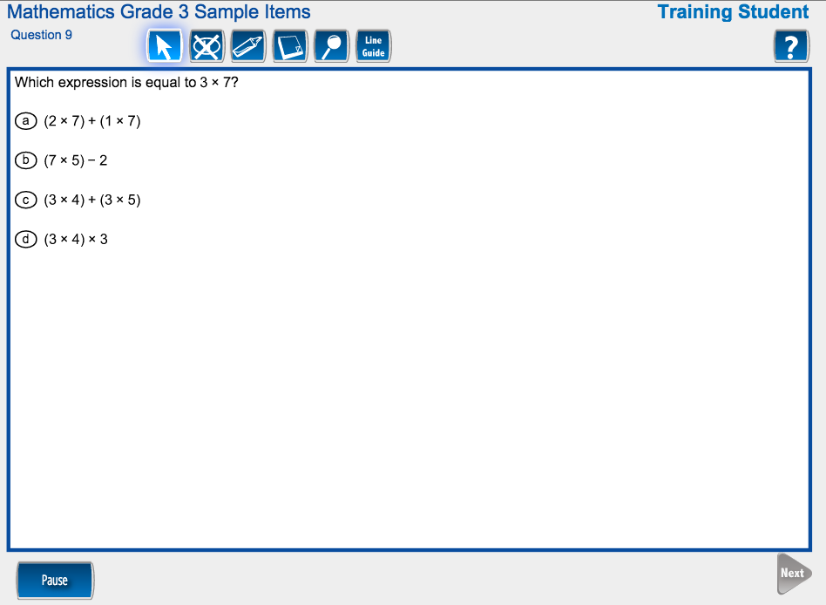

Slide 46
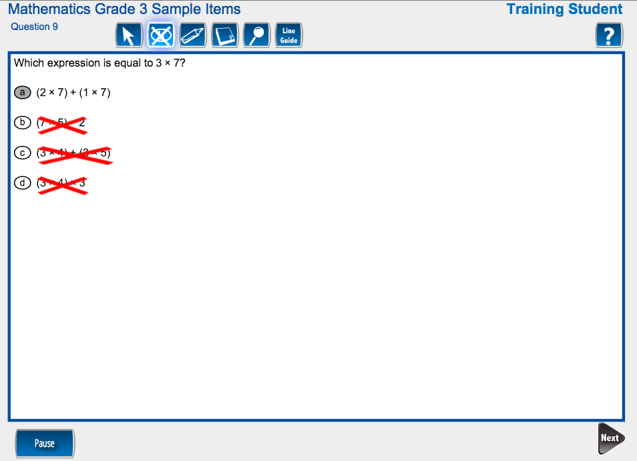

Slide 47
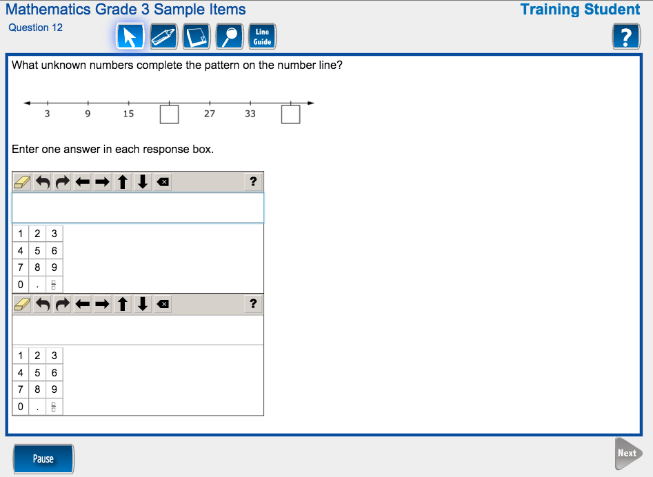
21
39

Slide 48
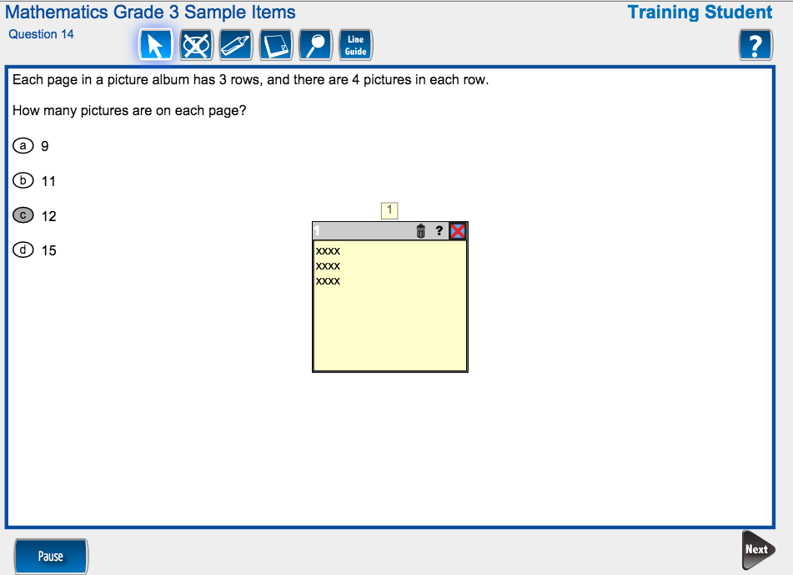

Slide 49
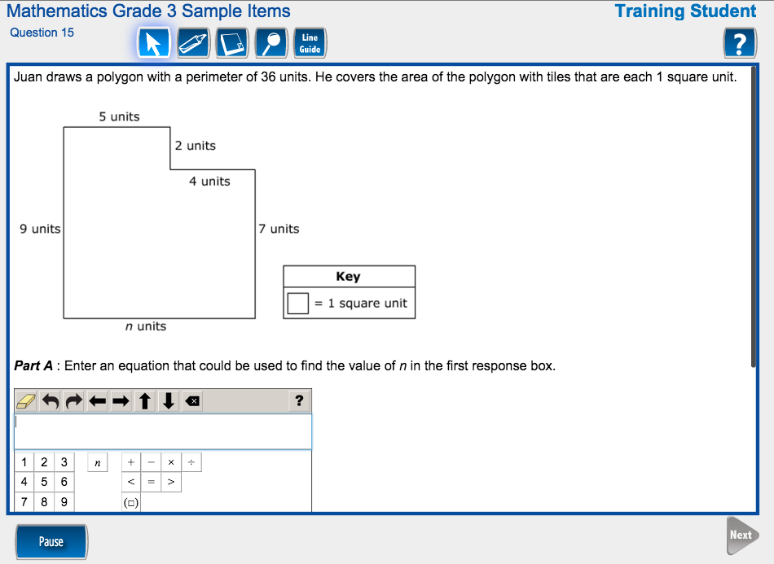

Slide 50
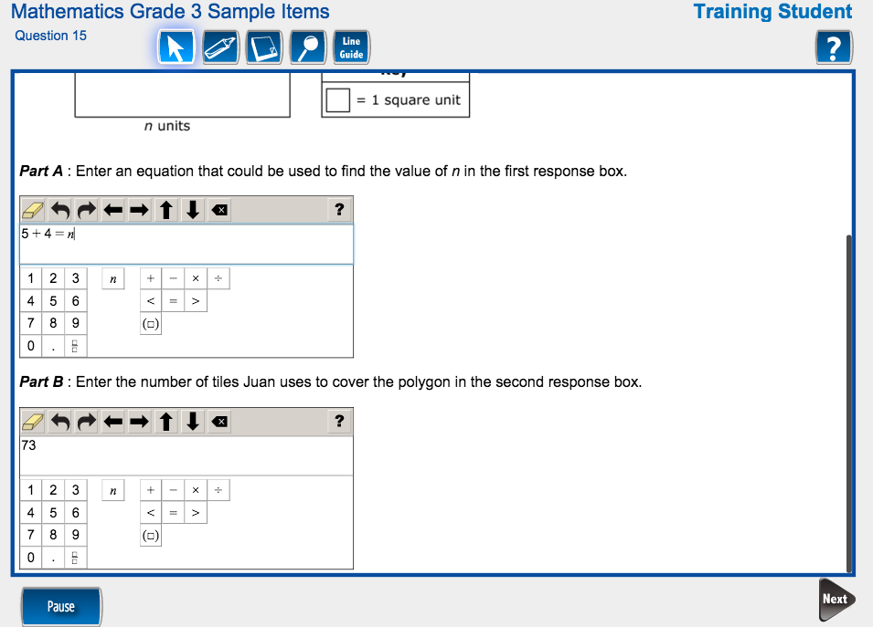

Slide 51
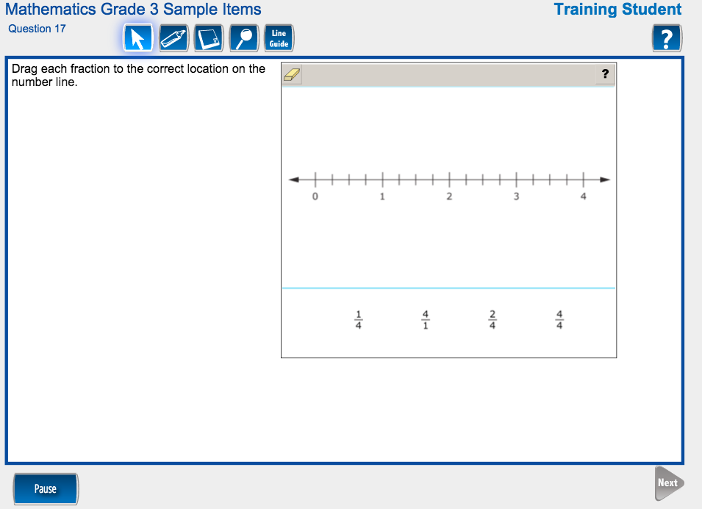

Slide 52
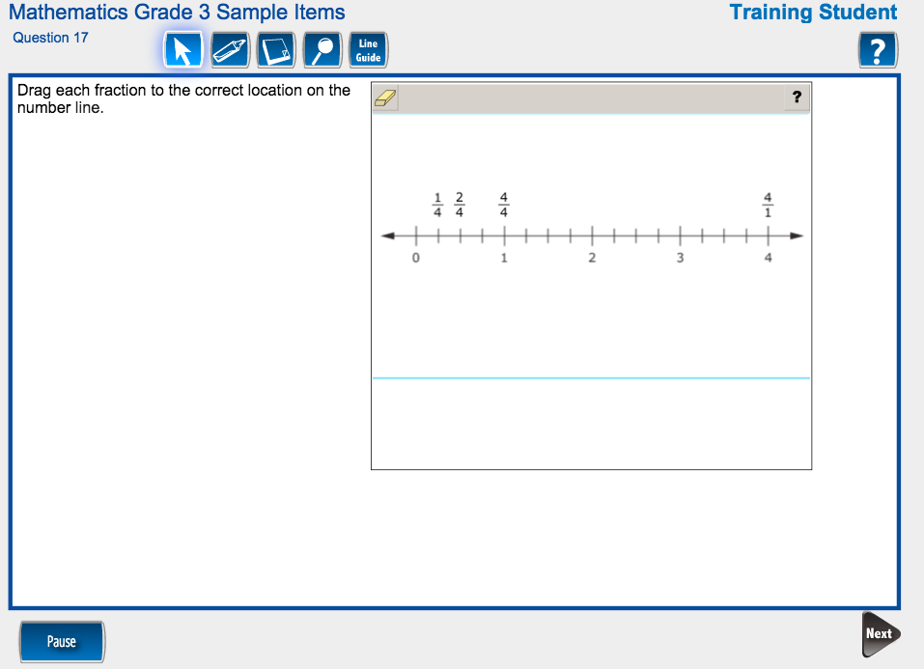

Slide 53
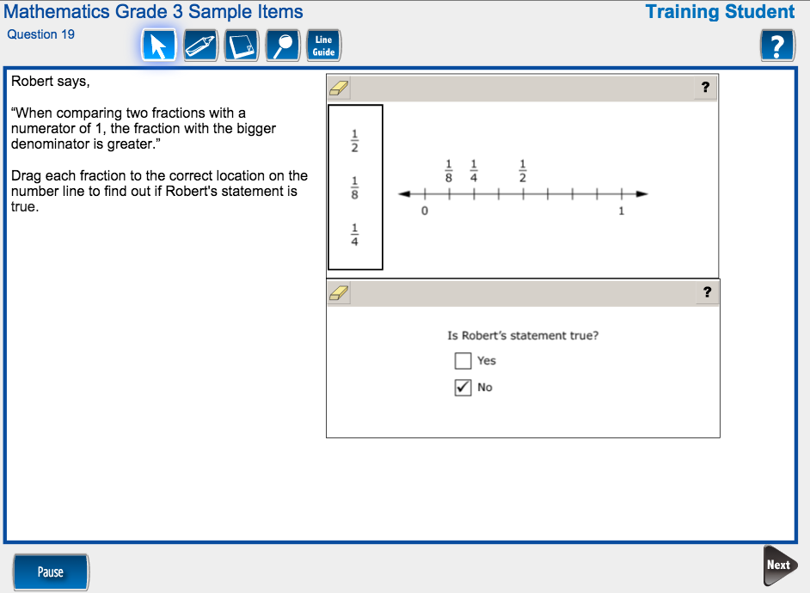

Slide 54
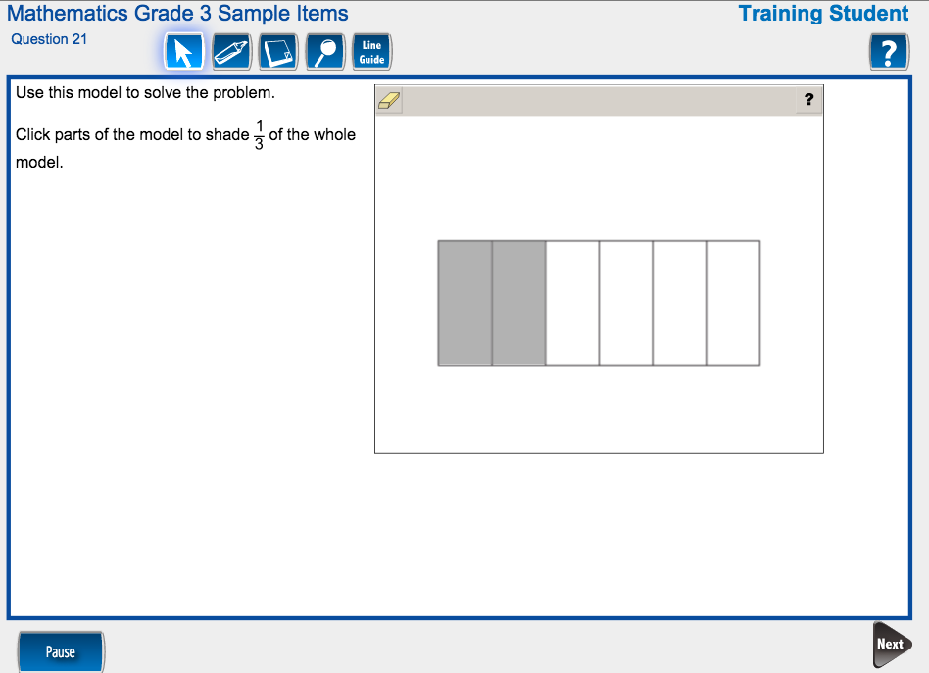

Slide 55
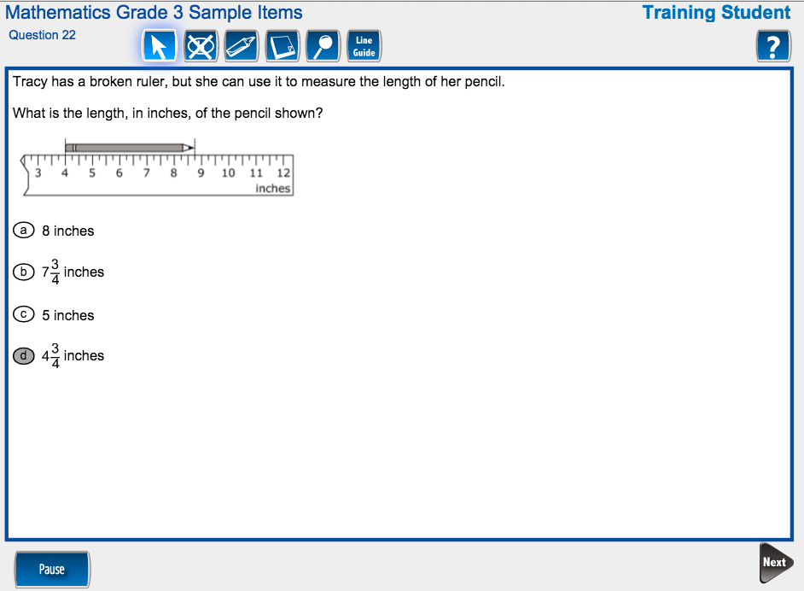

Slide 56
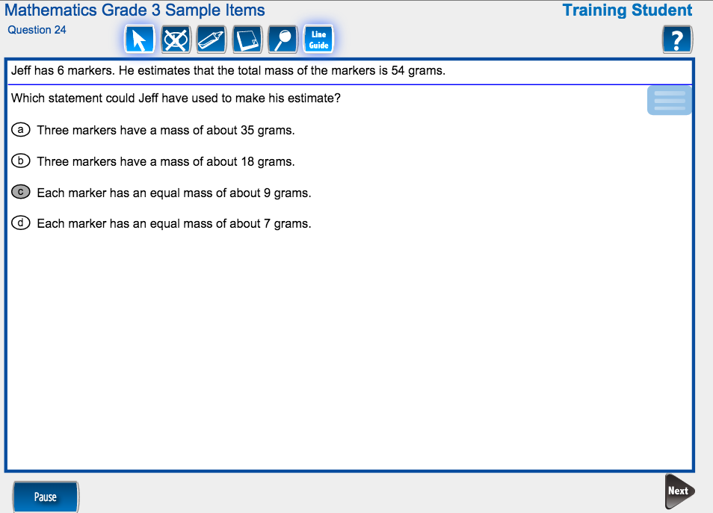

Slide 57
Preview Performance Tasks

Slide 58
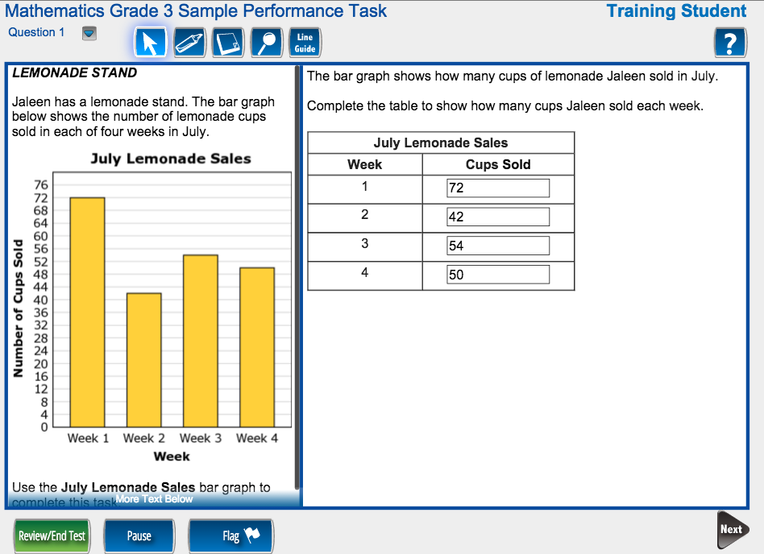

Slide 59
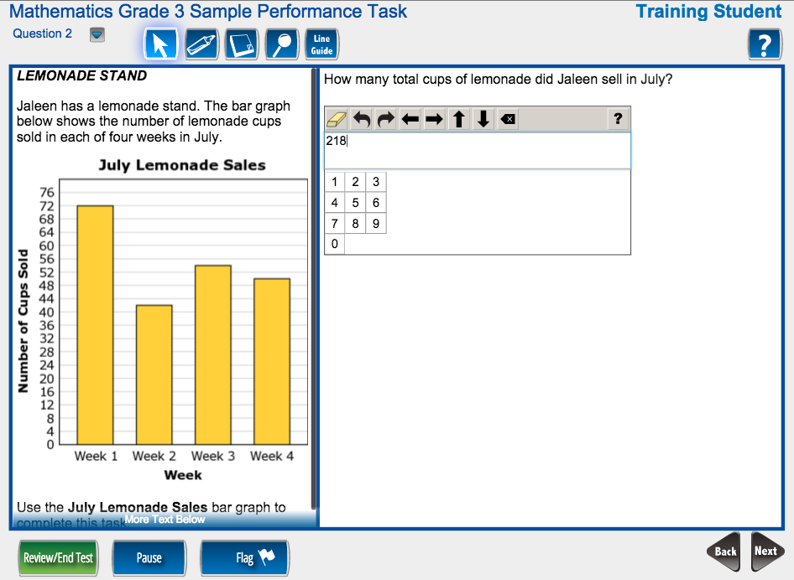

Slide 60
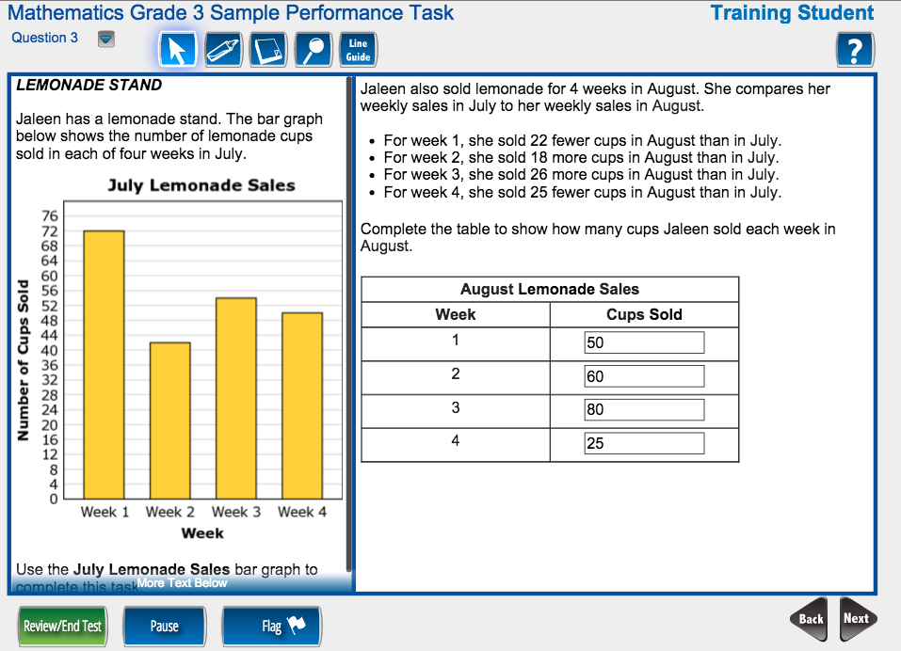

Slide 61


Slide 62
ALEKS Practice Problems

Slide 63


Slide 64


Slide 65


Slide 66


Slide 67


Slide 68


Slide 69


Slide 70


Slide 71


Slide 72


Slide 73


Slide 75


Slide 76
Practice Performance Tasks
Inside Mathematics and Engage NY

Slide 77


Slide 78


Slide 79



Slide 80


Slide 81


Slide 82


Slide 83


Slide 84


Slide 85


Slide 86


Slide 87


Slide 88


Slide 89
Now, go out there and MSTEP!

